Slide 1
Android performance

Slide 2
Agenda
Why performance matters?
Battery
UI / Rendering
Memory
Network
Q & A

Slide 3
Why performance matters?
Users leave apps for two reasons — either the quality of content is not very good, or the app performance is too slow.
Measure first
Project Butter
Project Svelte

Slide 4

Battery PERFORMANCE
Battery life – most important feature
Surveys
Battery Life Is the Only Spec That Matters
Survey shows battery life to be the single main gripe of today's mobile phone user
The smartphone spec that matters most
Long battery life is most important feature for smartphone users, finds survey
Smartphone Battery Survey: Battery Life Considered Important

Slide 5
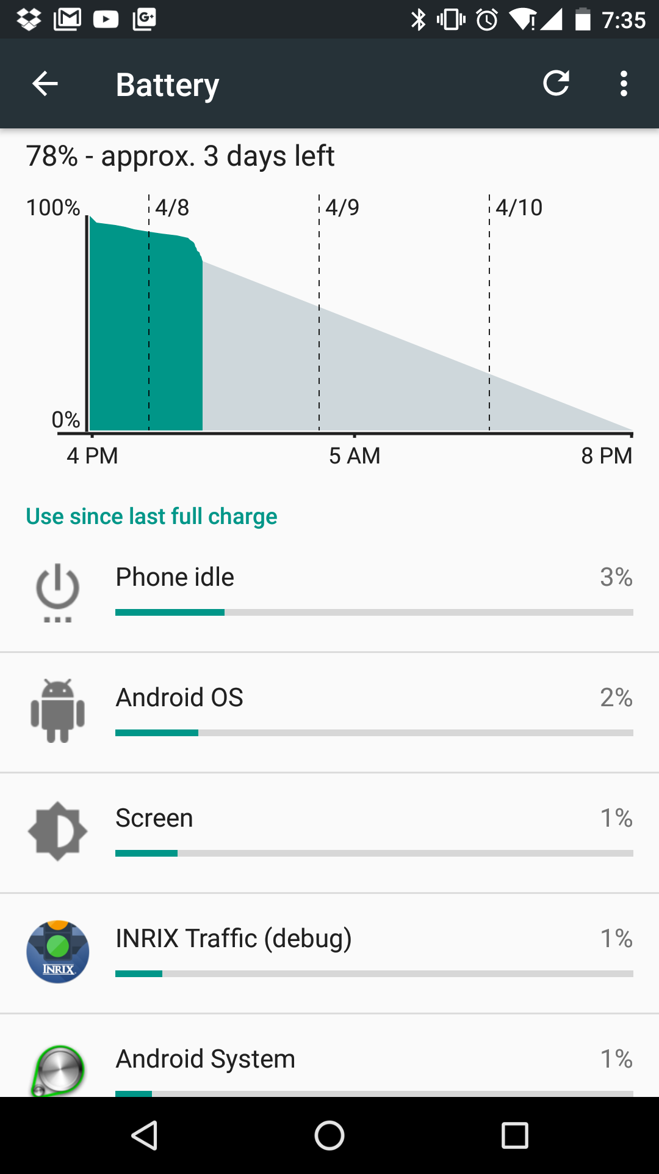
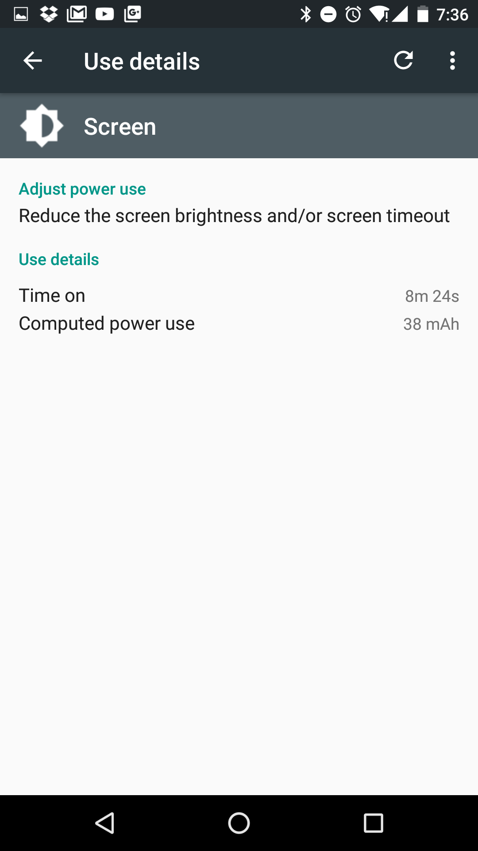
Battery PERFORMANCE
Power profile
https://source.android.com/devices/tech/power
Notes:
APKTool
Power profile

Slide 6
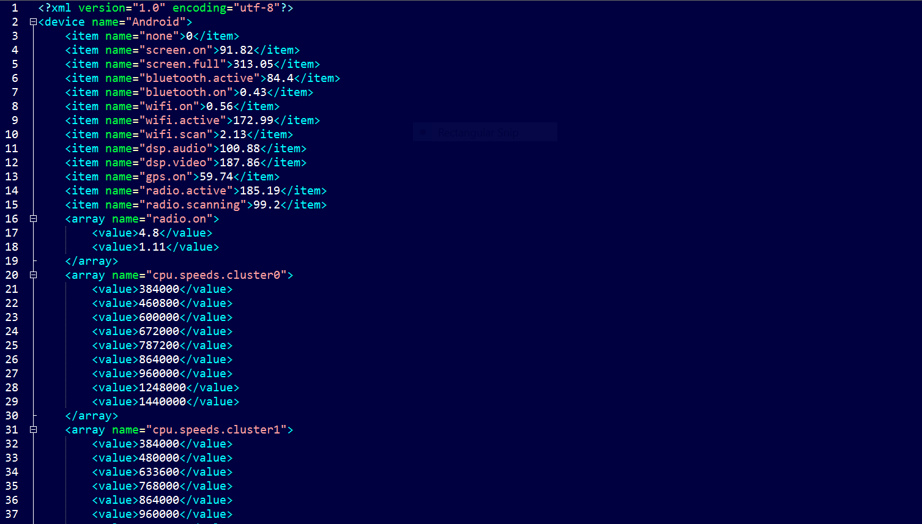

Slide 7
Battery PERFORMANCE
ADB
adb shell dumpsys batterystats <package-name>
https://source.android.com/devices/tech/power/batterystats.html

Slide 8
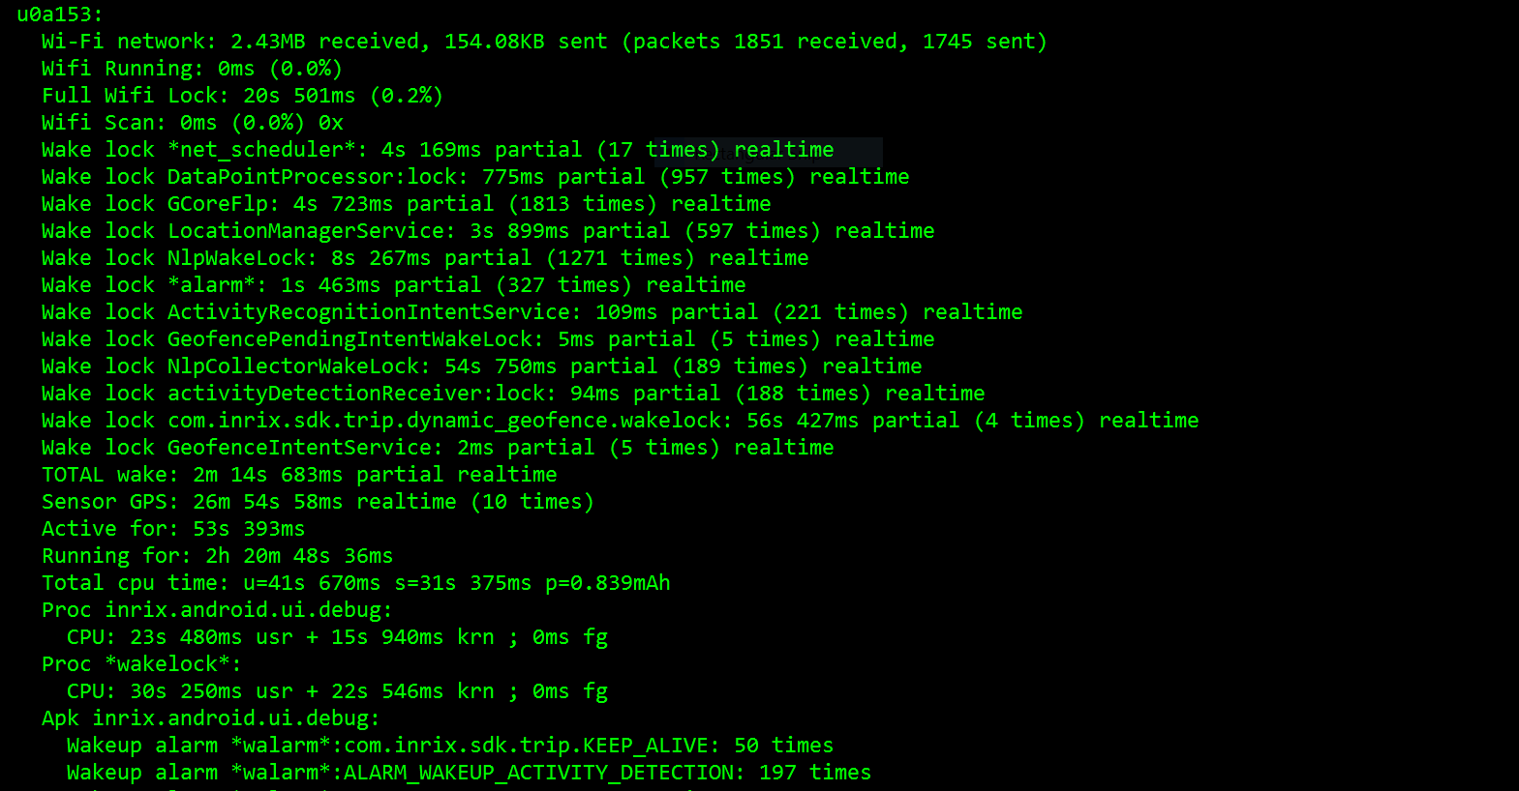

Slide 9
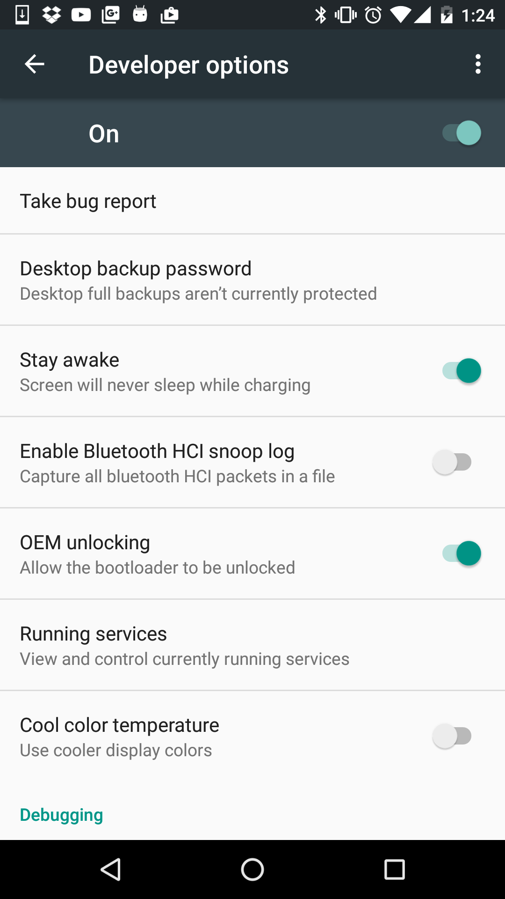
Battery PERFORMANCE
Project Volta
Bug report
Battery Historian
ADB commands
adb bugreport
adb shell dumpsys batterystats --reset
adb shell dumpsys batterystats --enable full-wake-history

Slide 10
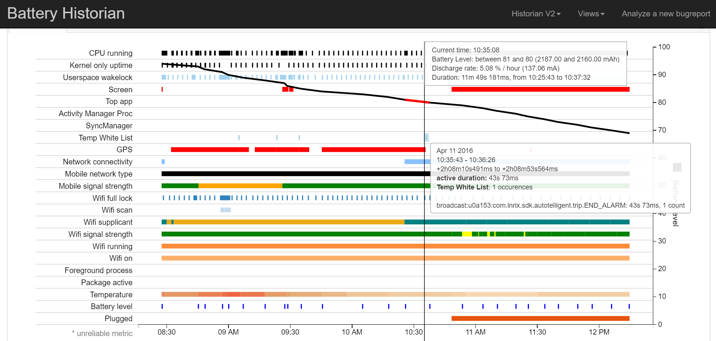

Slide 11
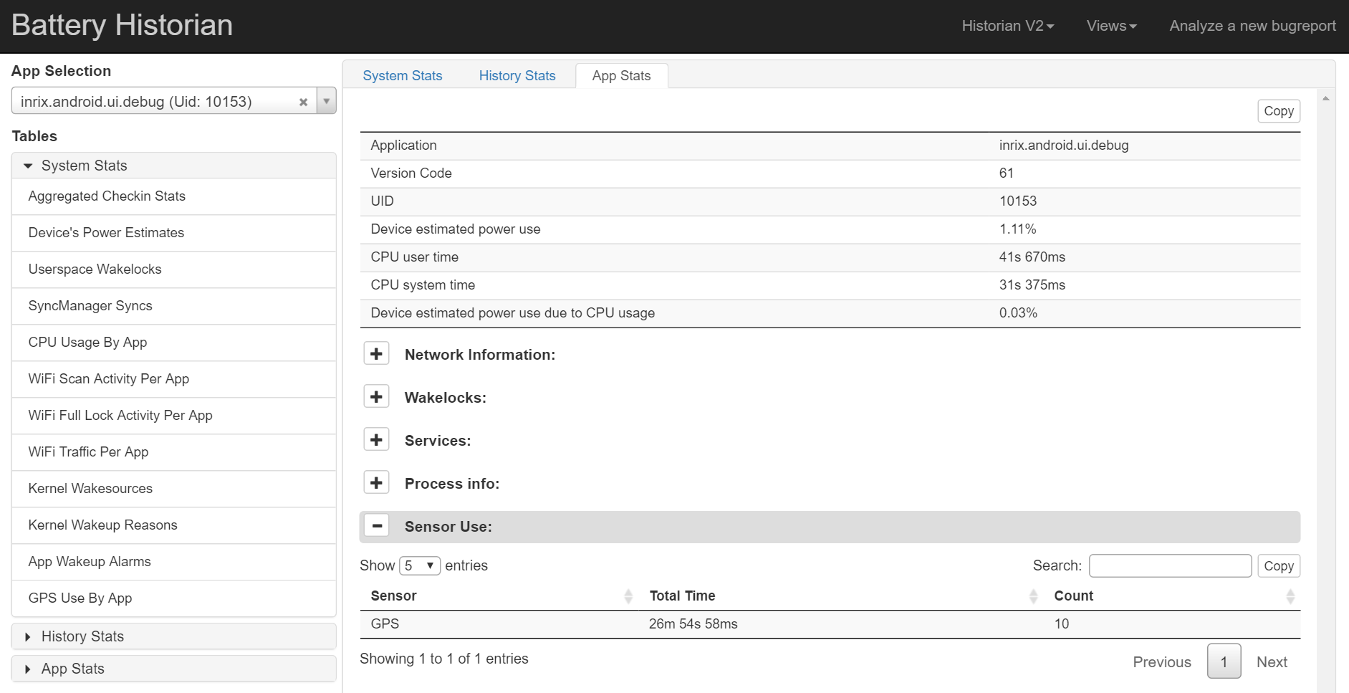

Slide 12
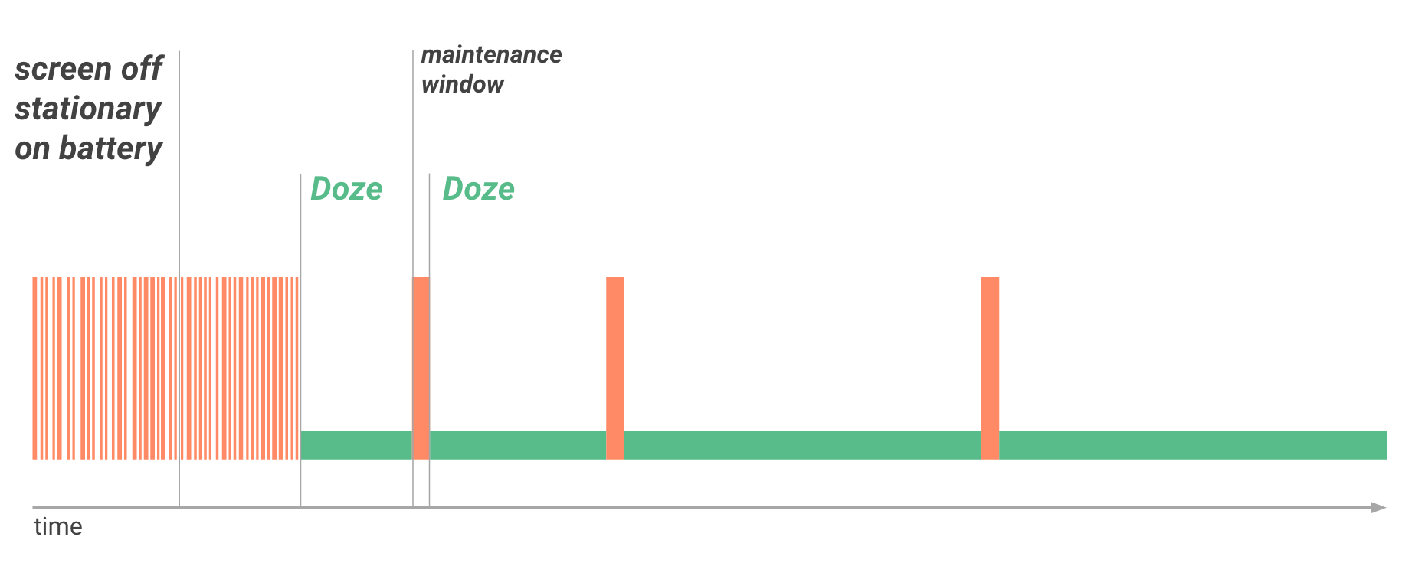
Battery PERFORMANCE
Doze and App Standby
http://developer.android.com/training/monitoring-device-state/doze-standby.html

Slide 13
Battery PERFORMANCE
Doze and App Standby – ADB commands
Doze mode:
adb shell dumpsys battery unplug
adb shell dumpsys deviceidle step
Enter AppStandby:
adb shell dumpsys battery unplug
adb shell am set-inactive <packageName> true
Exit AppStandby:
adb shell am set-inactive <packageName> false
adb shell am get-inactive <packageName>

Slide 14
UI Performance
16 ms
Jank
Where to look first
Overdraw
View complexity
GPU rendering / Systrace
Traceview
Blocking UI threads

Slide 15
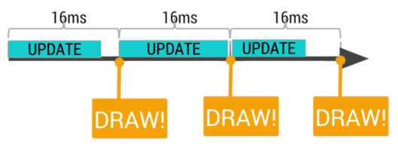
UI Performance
16 ms = 60 fps

Slide 16
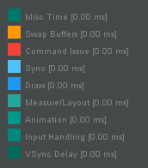
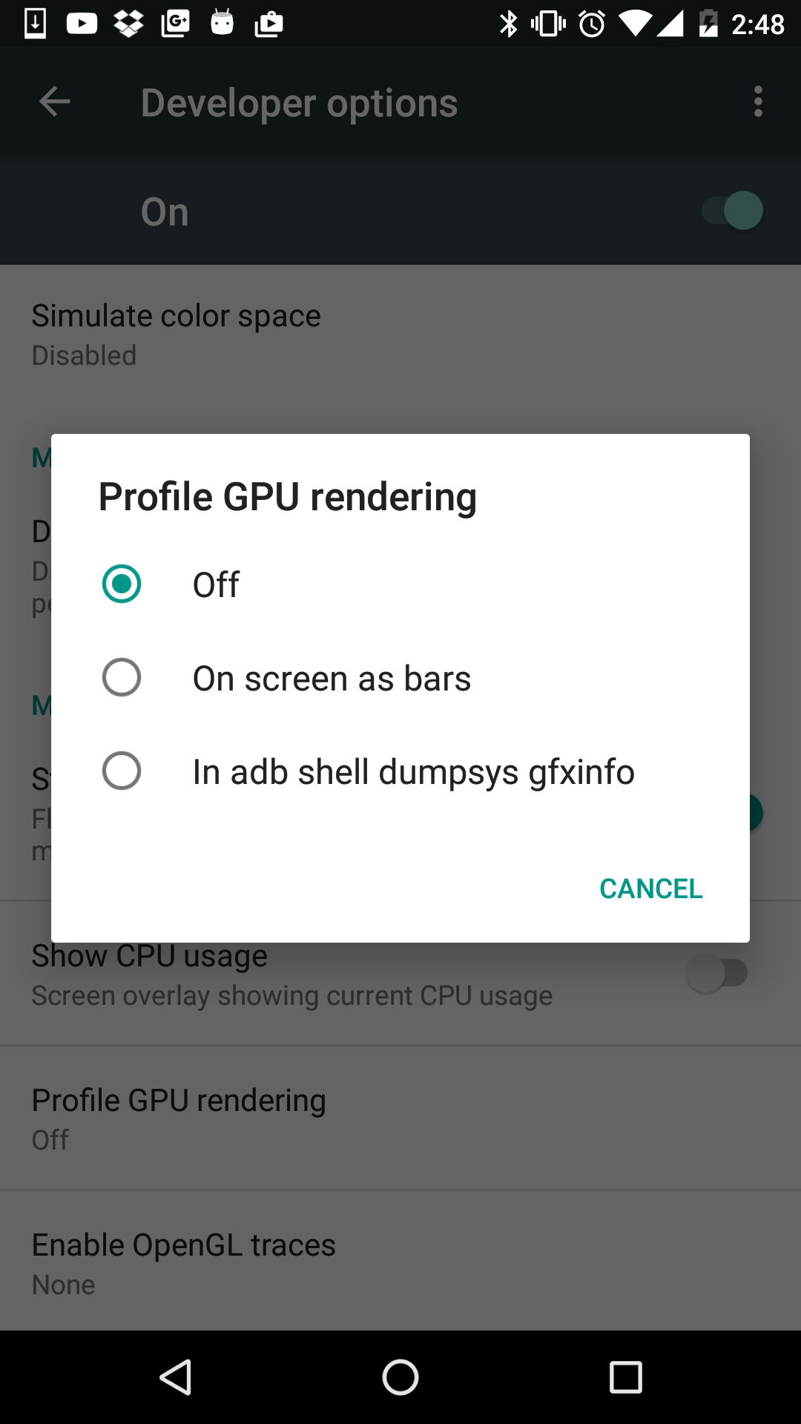
UI Performance
Profile GPU rendering

Slide 17
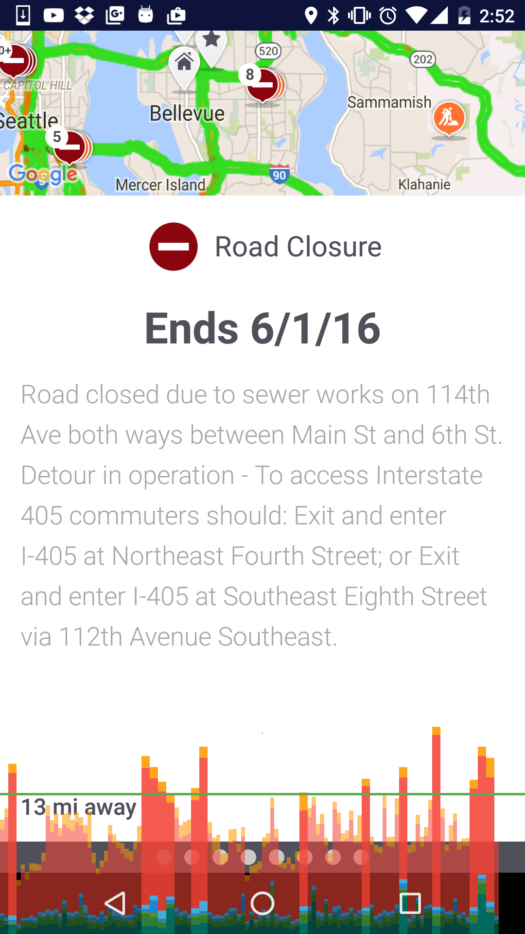
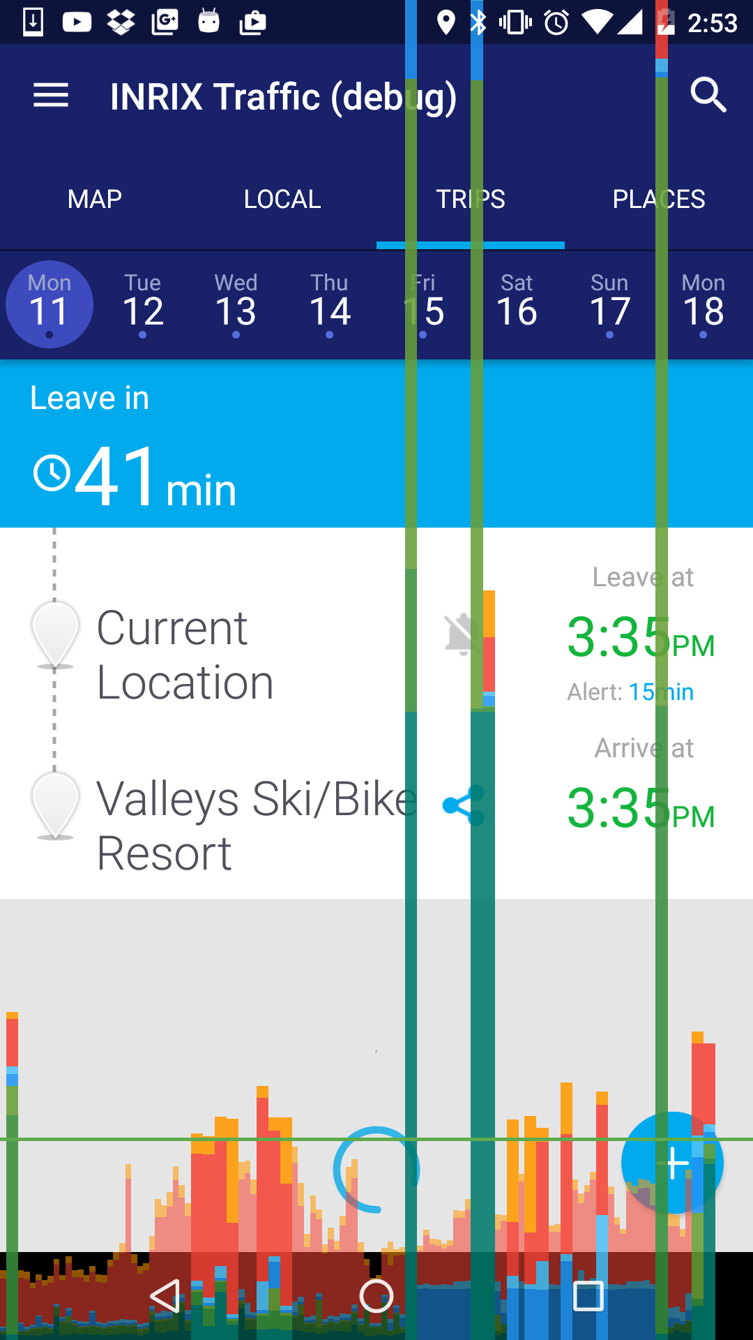
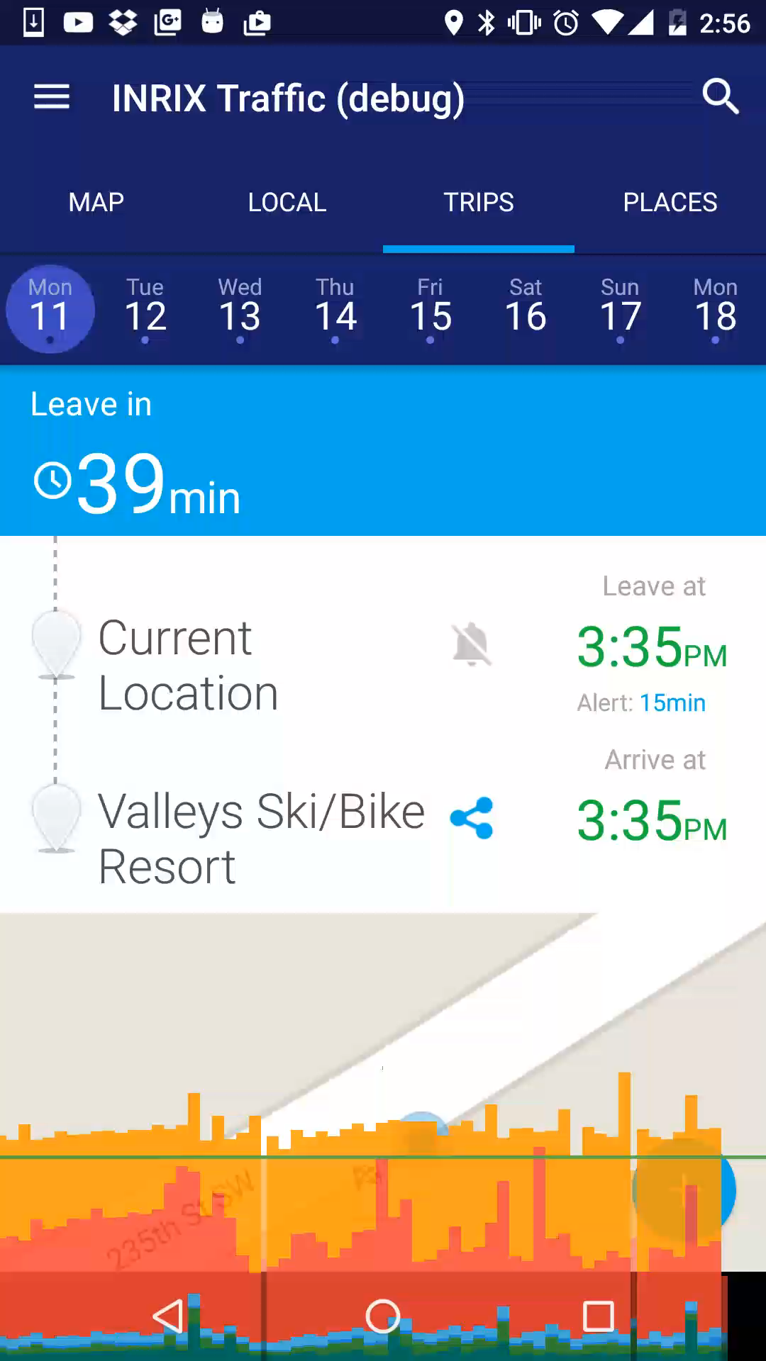
Profile GPU rendering

Slide 18
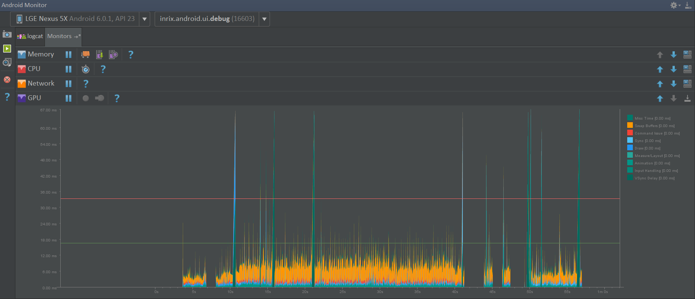

Slide 19
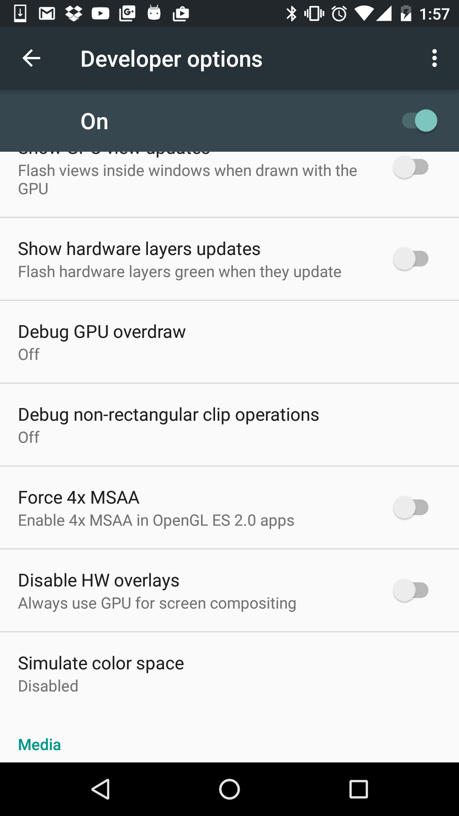
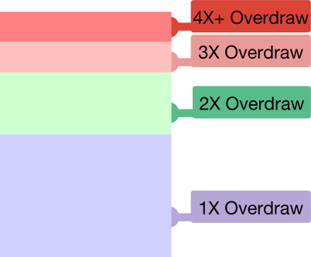
UI Performance
Overdraw

Slide 20
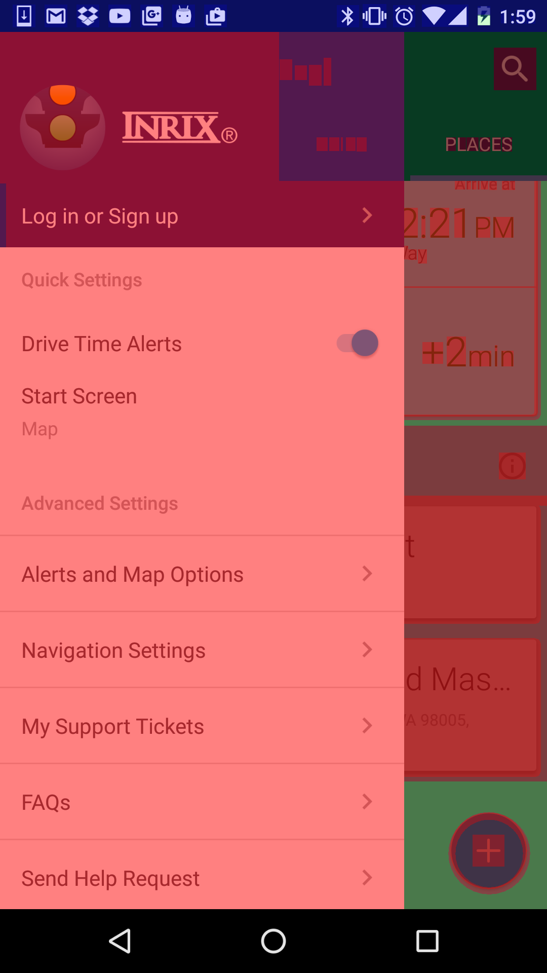
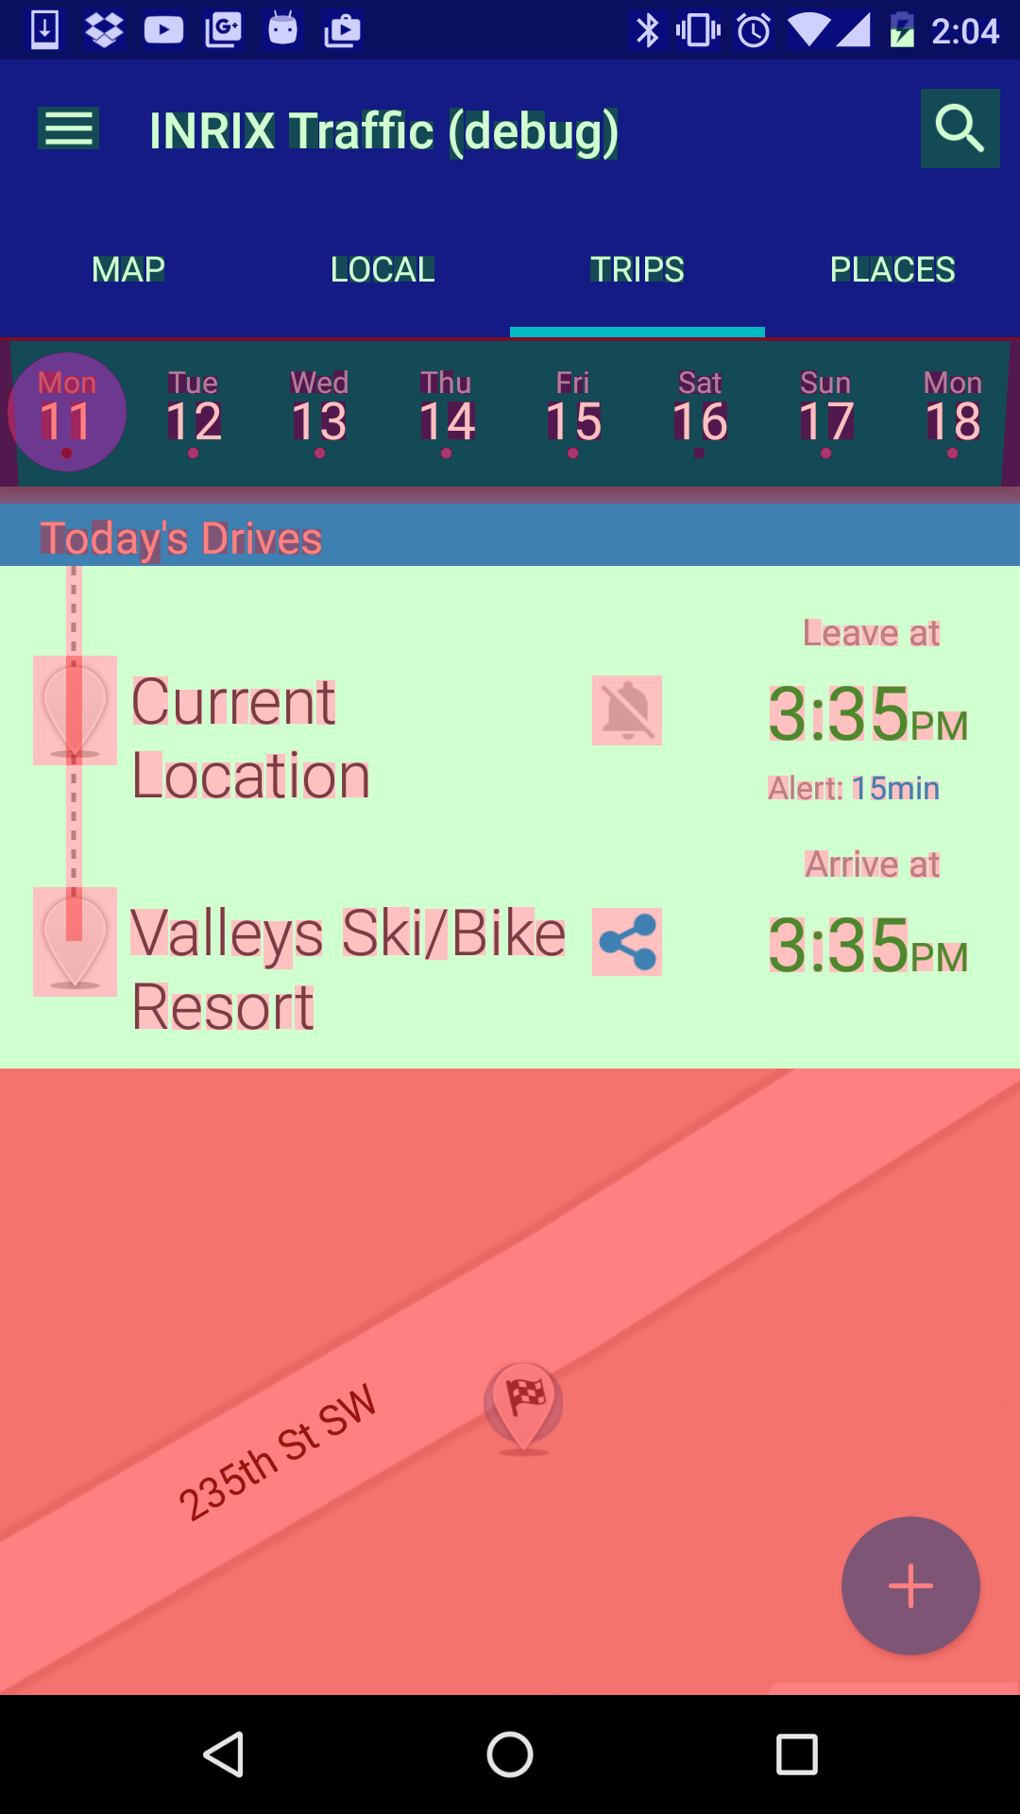
UI Performance
Overdraw - BAD

Slide 21
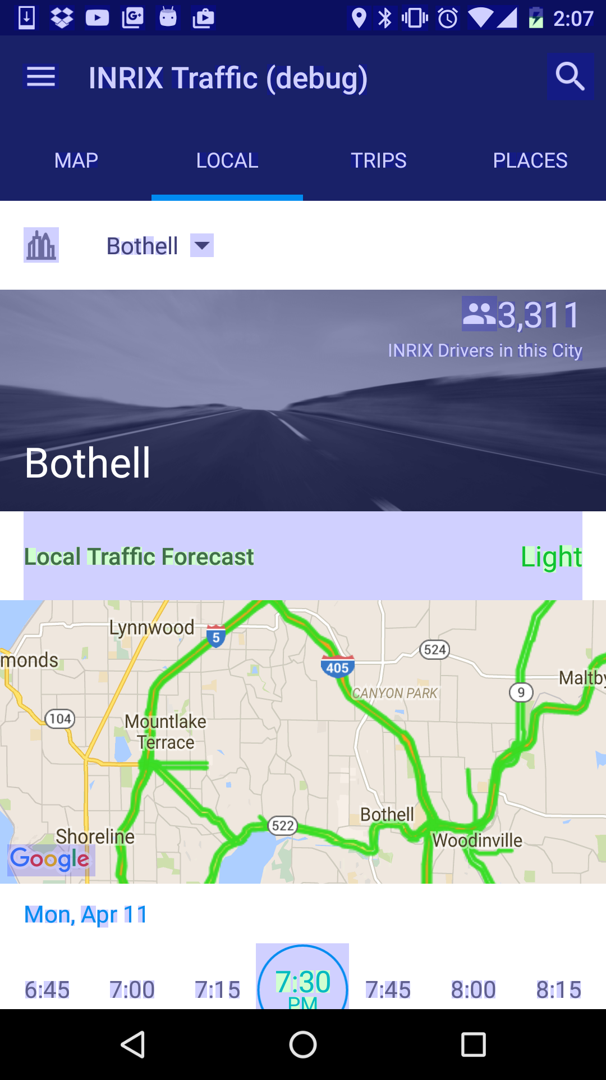
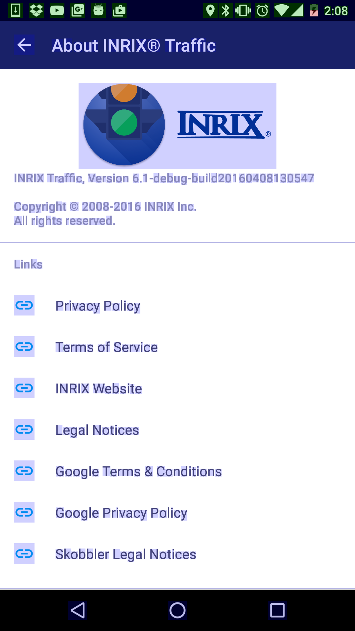
UI Performance
Overdraw - GOOD

Slide 22
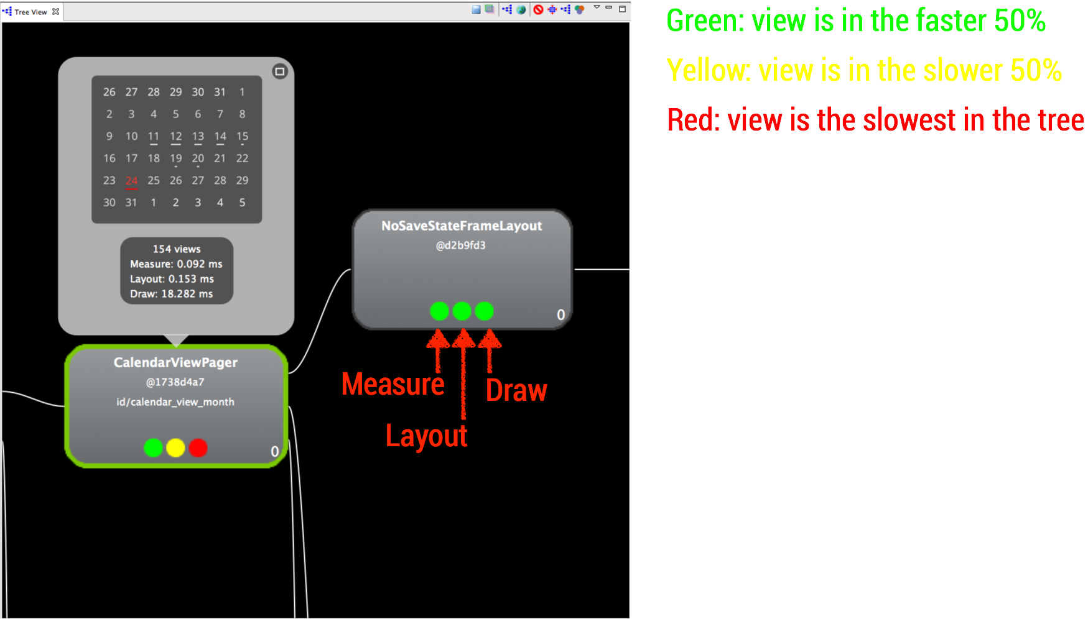
UI Performance
Hierarchy viewer
ViewServer

Slide 23
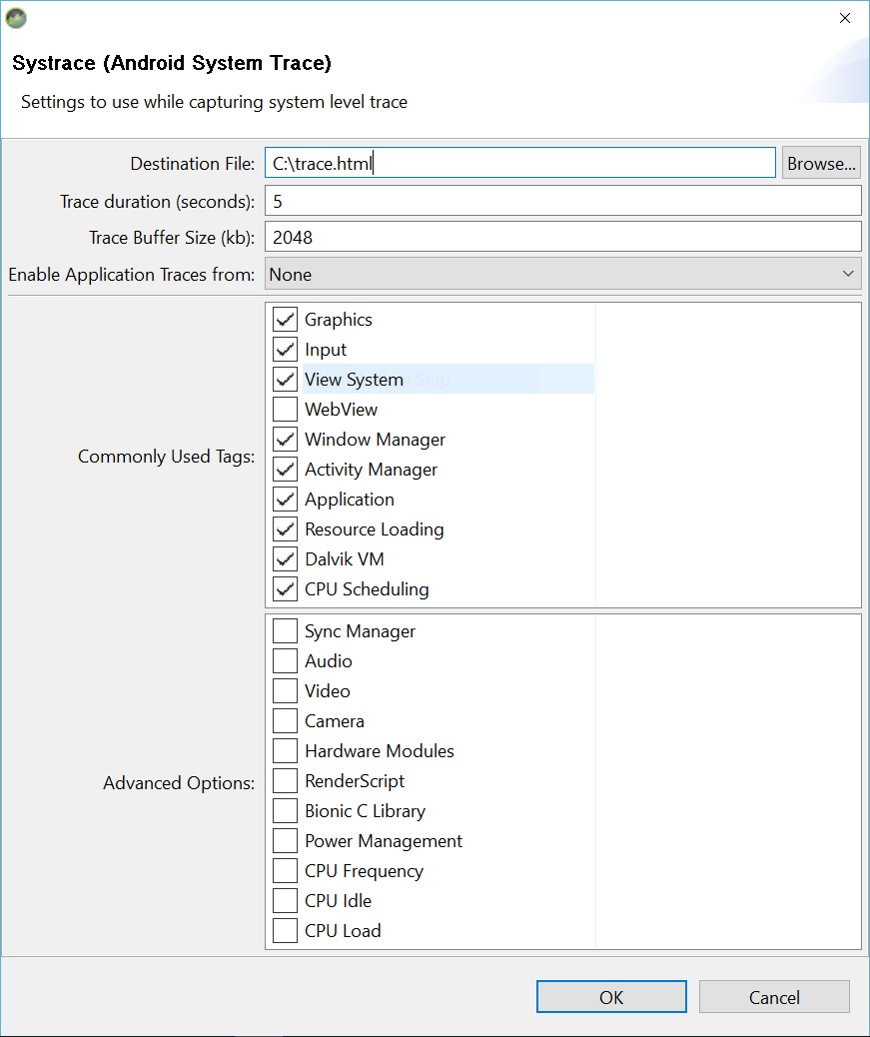
UI Performance
Systrace

Slide 24
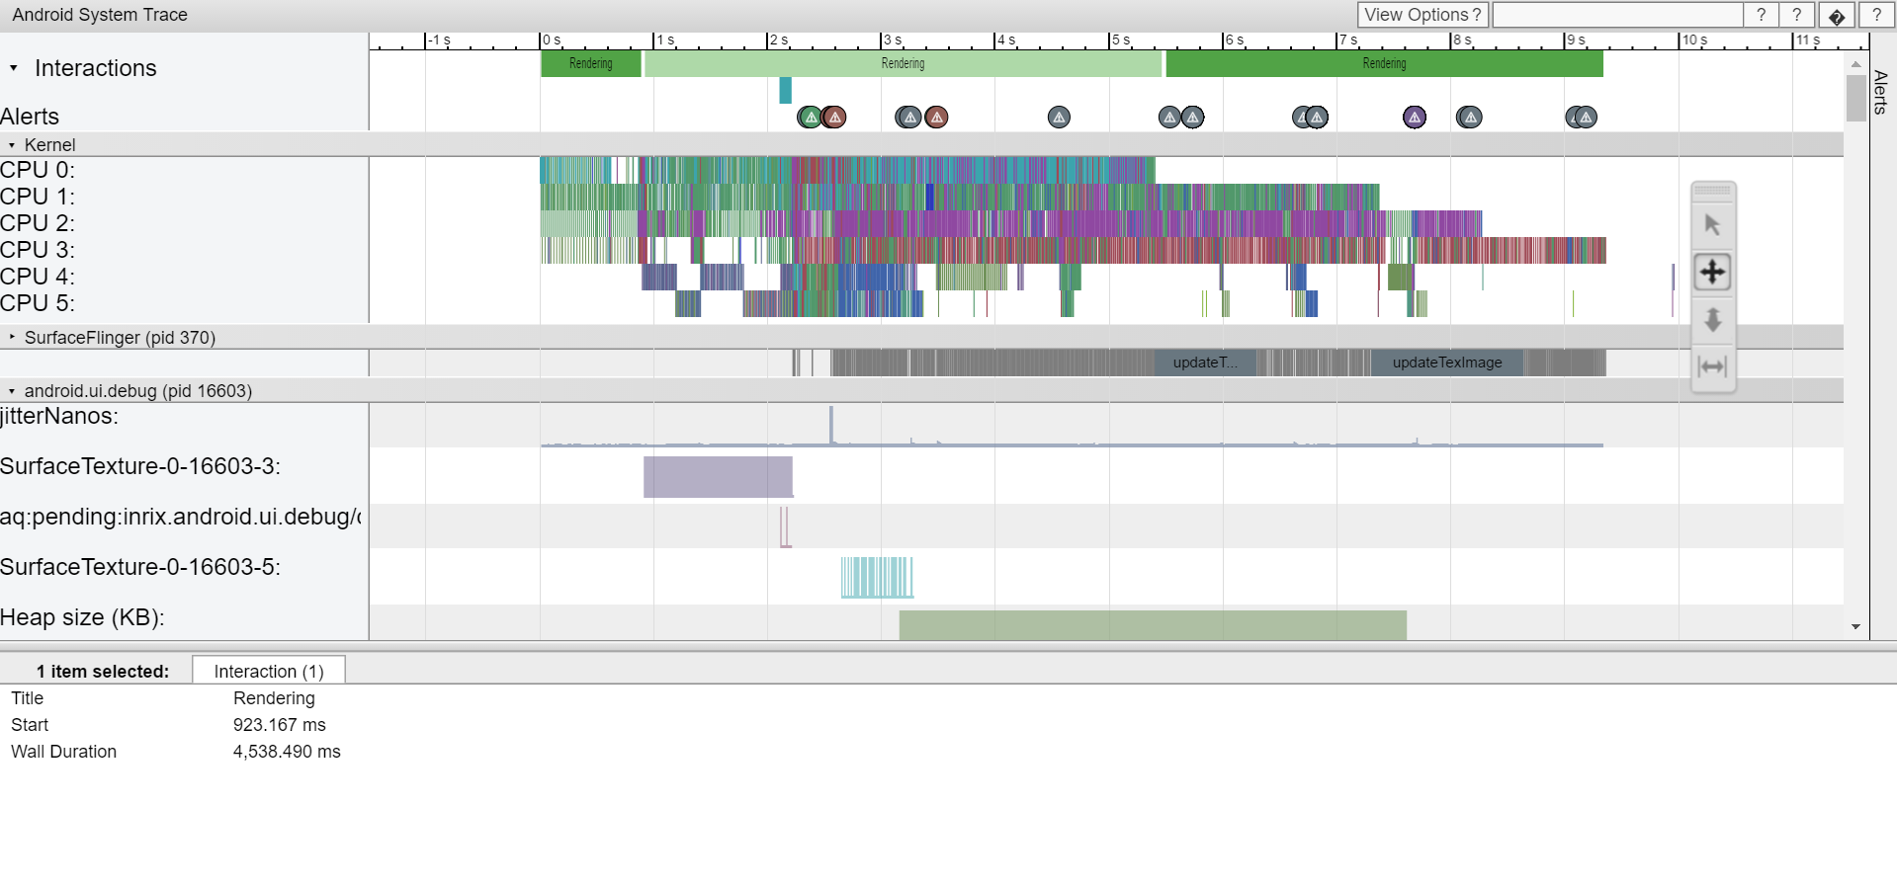

Slide 25
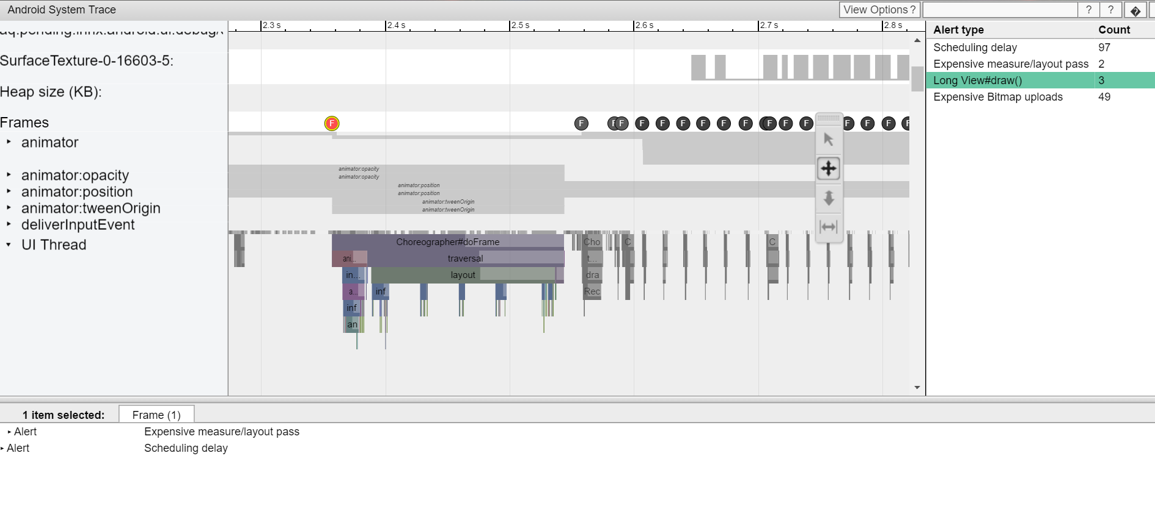

Slide 26
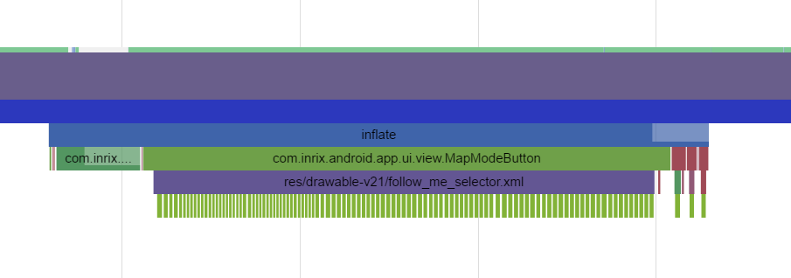
UI Performance
Systrace demo

Slide 27
UI Performance
Trace View
Strict Mode
Logging

Slide 28
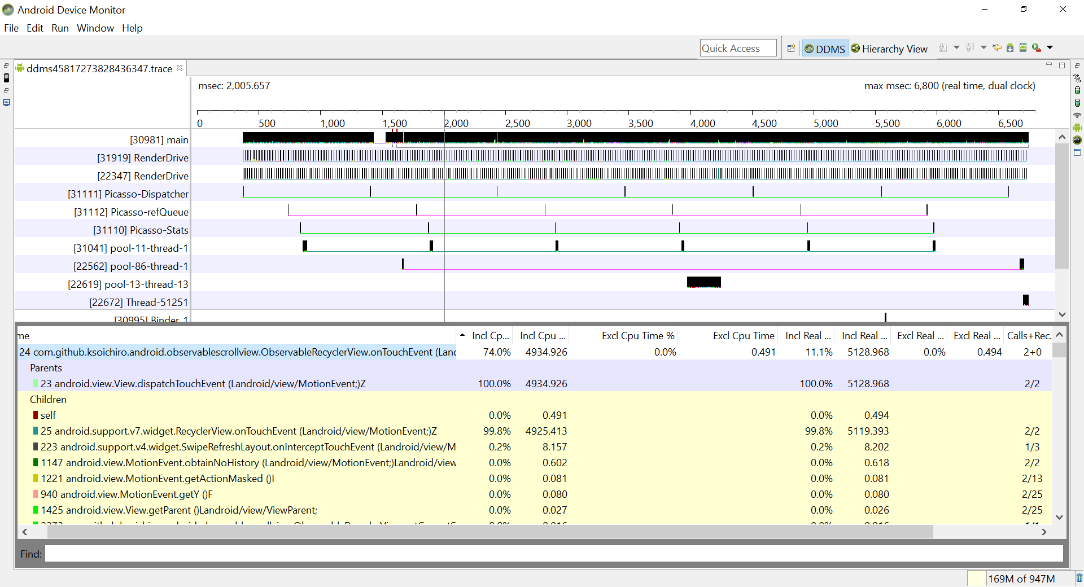

Slide 29
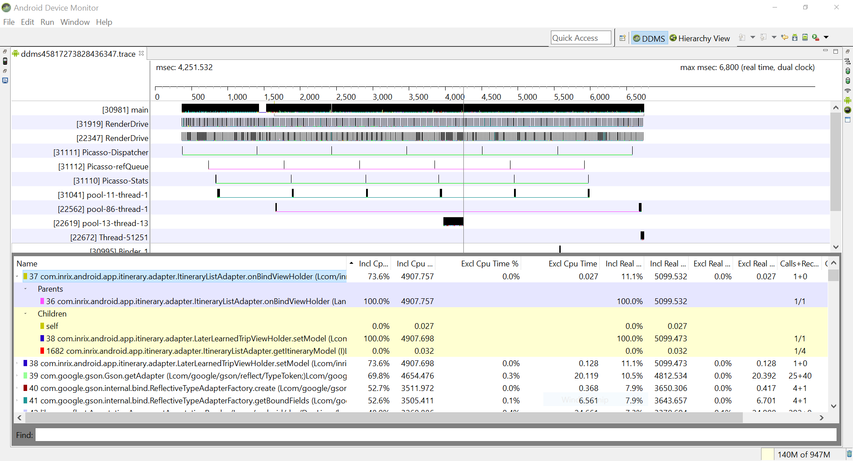

Slide 30
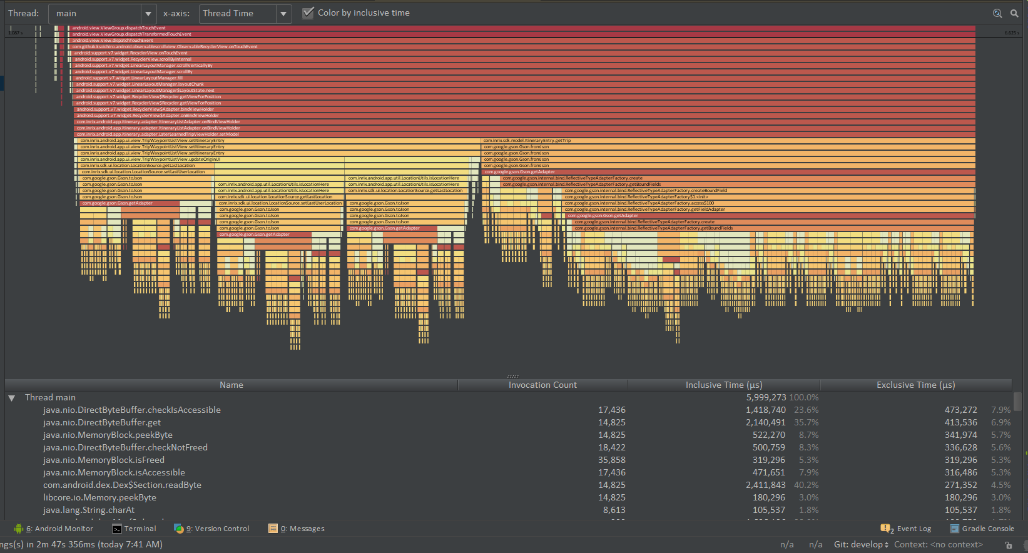
Notes:
LaterLearnedTripViewHolder::setModel
TripWaypointListView::setItineraryEntry (lc: 237)
ItineraryEntry::getTrip

Slide 31
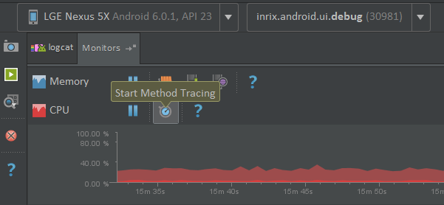
Android Studio method tracing

Slide 32
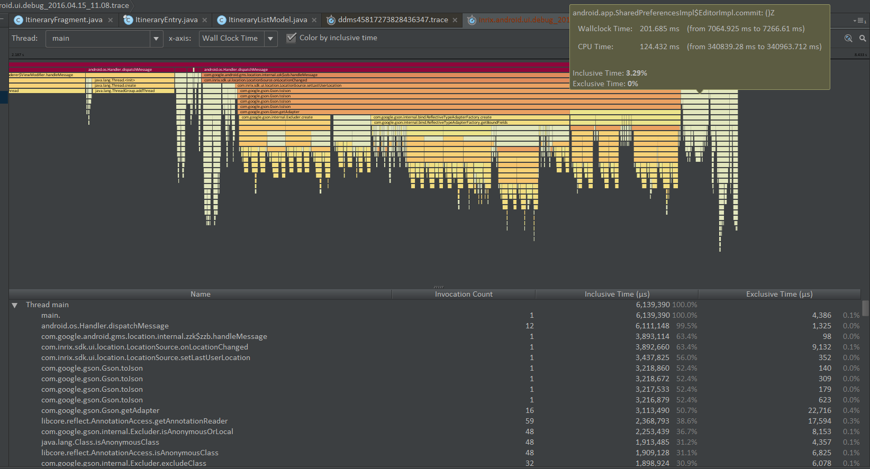

Slide 33
Memory performance
Memory allocation and garbage collection in Dalvik and ART

Slide 34
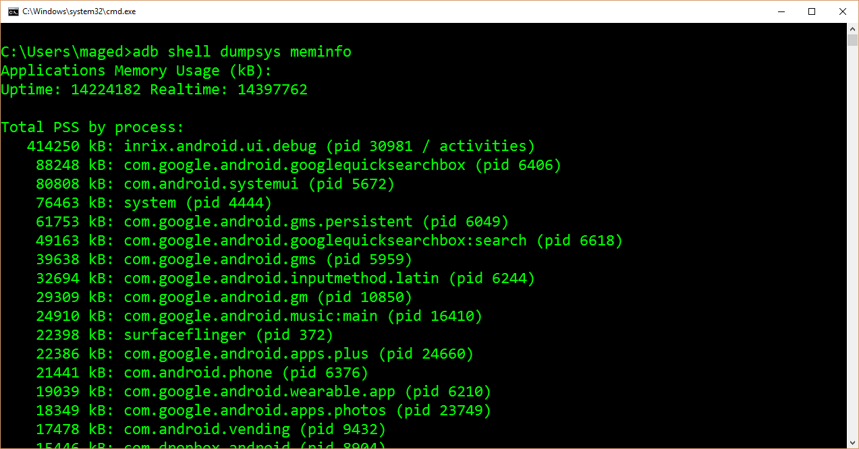
Memory performance
adb shell dumpsys meminfo

Slide 35
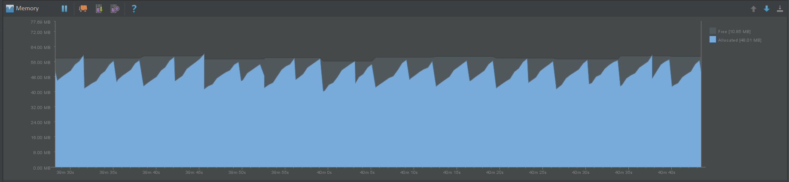
Memory performance
Android Studio Memory Monitor

Slide 36
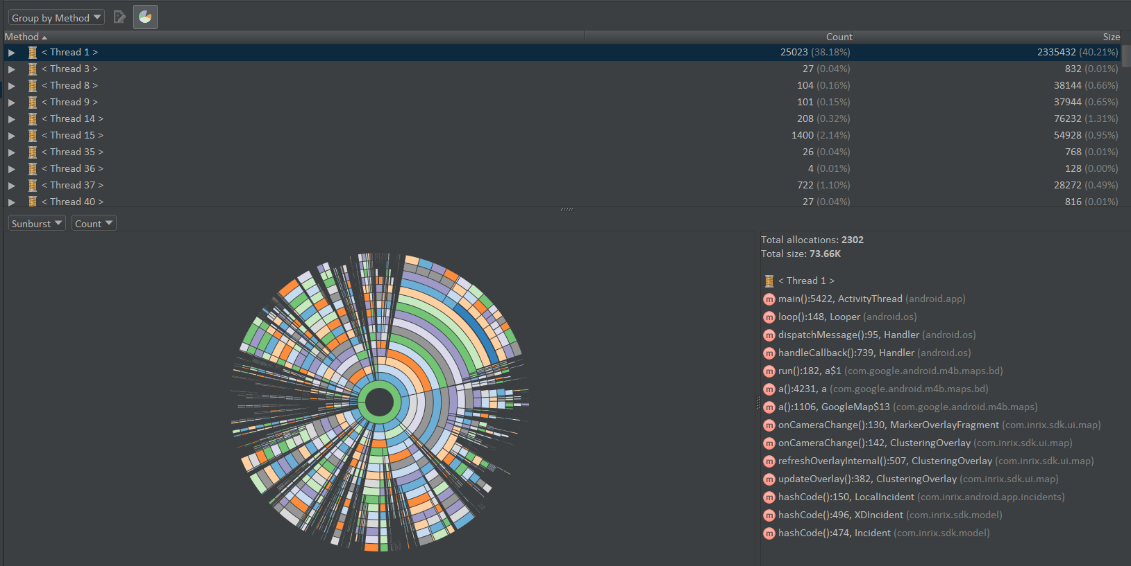

Slide 37
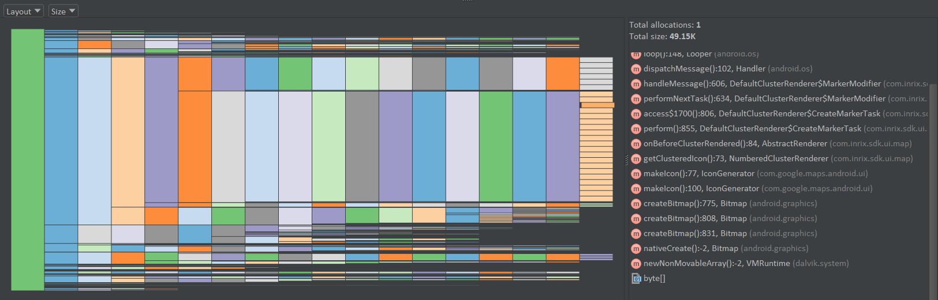
Android Studio – Allocation Tracker (size)

Slide 38
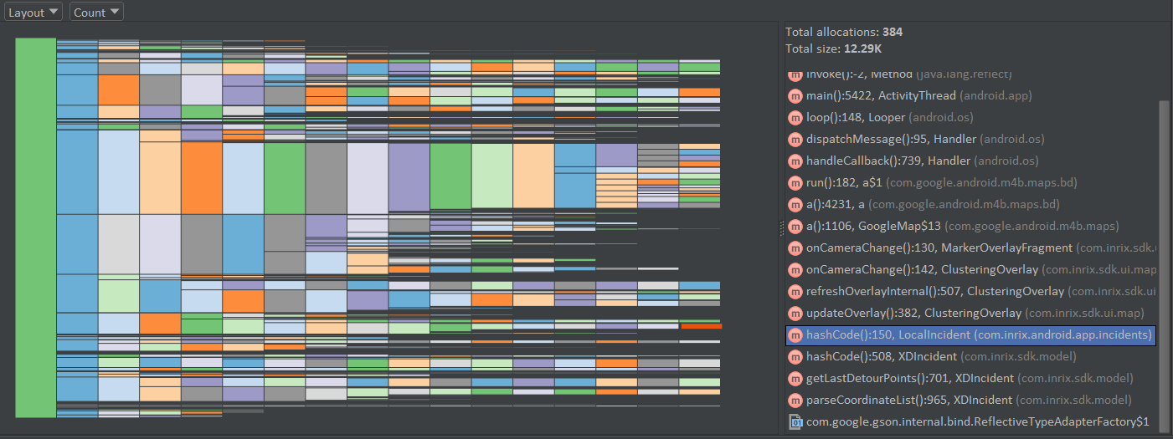
Android Studio – Allocation Tracker (count)

Slide 39
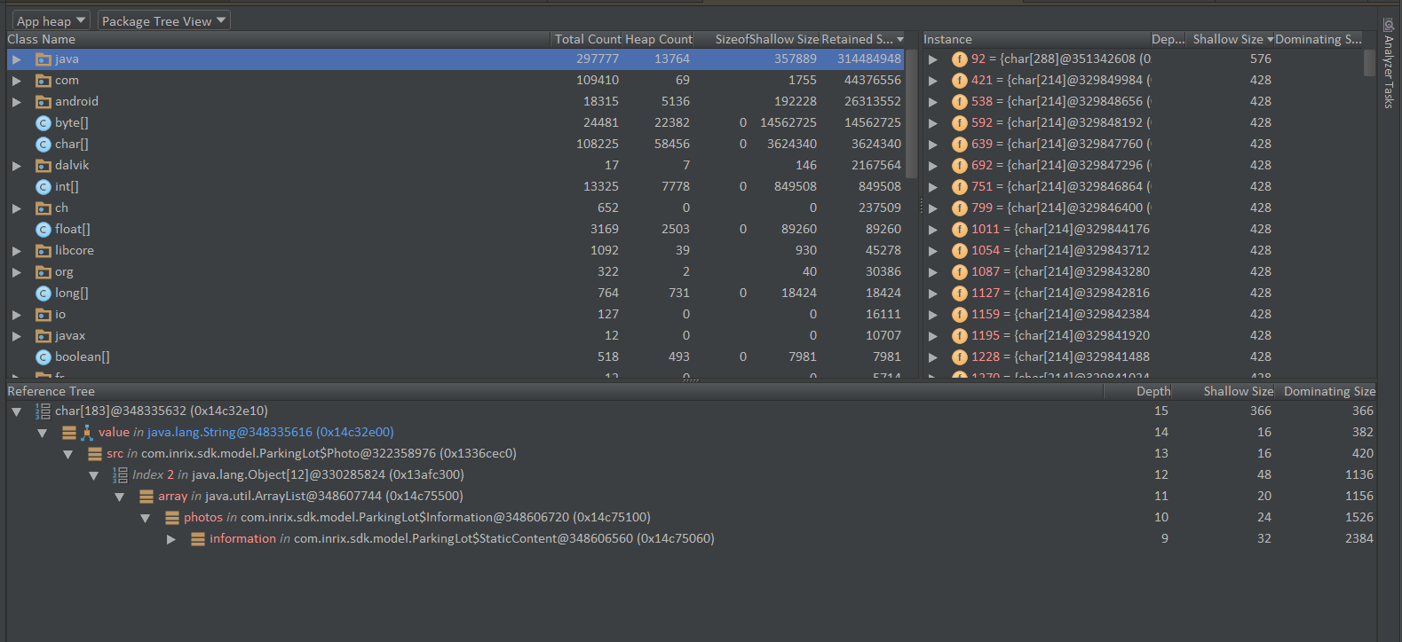
Android Studio – Memory Dump

Slide 40
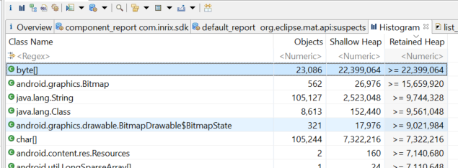
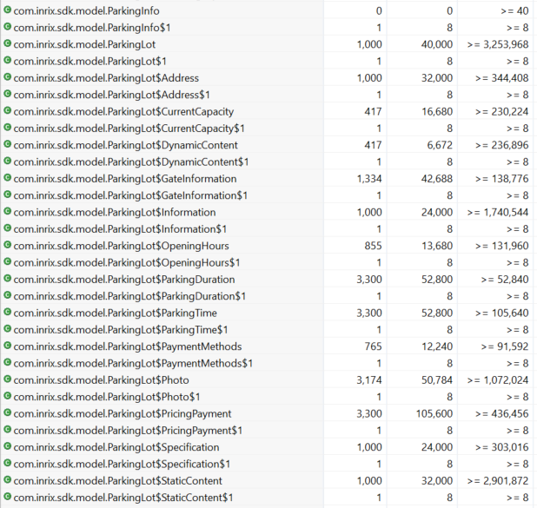
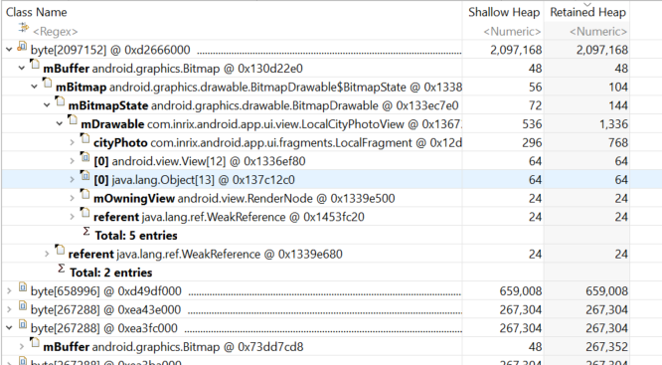

Slide 41
Memory performance
Profiling memory use
Heap dumps
Android Studio Heap Viewer
Android Studio Allocation Tracker
MAT
LeakCanary

Slide 42
NETWORK PERFORMANCE
Profiling
Optimizing
Grouping connections
Optimizing resources
Connection management
Slow network testing

Slide 43
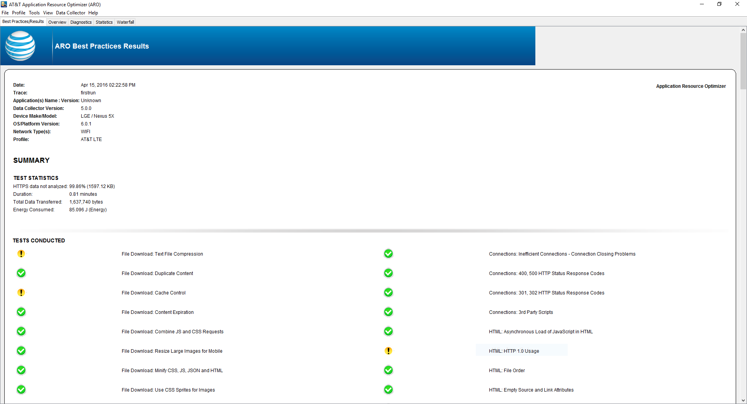

Slide 44
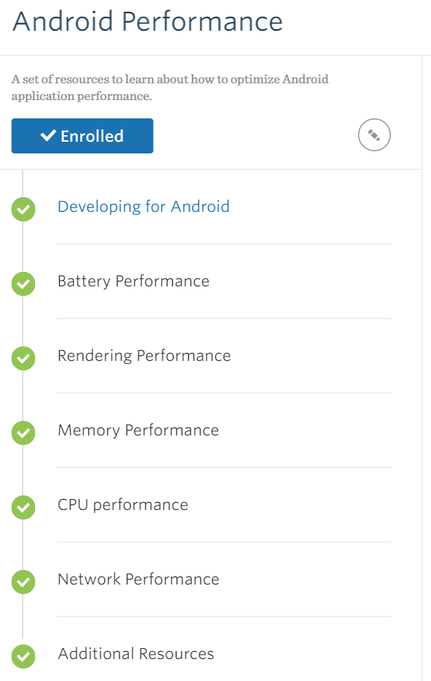

degreed
https://degreed.com/paths?path=android-performance&id=51939

Slide 45
Resources
APKTool http://ibotpeaches.github.io/Apktool/
Battery Historian
https://github.com/google/battery-historian
MAT
http://www.eclipse.org/mat/
LeakCanary
https://github.com/square/leakcanary
AT&T Resource Optimizer
https://developer.att.com/application-resource-optimizer

Slide 46
Q & A
Thanks!

